Slide 1
CEG 4424/6424 Midterm Review

Slide 2
Time and Location
All students will take the online exam.
the exam will be available Oct. 8th, 2025 (Wed.), 10:00AM to 10:00PM, EST
You will have 100 minutes to finish the midterm exam.
Students registered with the disability office will have 150 minutes.

Slide 3
Policy
This is a close-book midterm (you can use a hand-written cheat sheet)
You have totally 100 minutes to finish the midterm exam
You are not allowed to collaborate with other students during the exam
No aid given, received, or observed.
If your answers are not clear, you will lose points for them
You will be given credits only for what appears on your exam.
Students should never share questions or answers of this exam with other students

Slide 4
Questions
Questions
True/False
Filling blanks
Multiple choices
Short questions
Computation questions

Slide 5
Topics
Basic concepts
CIA triad, Security Objectives, Security Services, Security Features
Security Models
Design principles
Least privilege
Separation of privilege
……
Stream Cipher & Block Cipher
AES (Advanced Encryption Standard)
Block Cipher Mode of Operations
RSA Algorithm (Key generation, Encryption, Decryption)
Cryptographic Hash

Slide 6

Security Objectives
Security Requirements
Security Objectives
Security Features
Security Services
Digital Assets
Confidentiality
Integrity
Availability
Notes:
When you design a system, there are security requirements, or the security objectives.
After the system is in use, the system has security features, or we can say the system provides security services.

Slide 7
Bell-LaPadula
BLP consists of
Simple Security Condition: S can read O if and only if L(O) ≤ L(S)
*-Property (Star Property): S can write O if and only if L(S) ≤ L(O)
No read up, no write down

Slide 8
Biba’s Model (Strict Integrity Policy)
Let I(O) denote the integrity of object O and I(S) denote the integrity of subject S
Biba
S can write O if and only if I(O) ≤ I(S)
(if S writes O, the integrity of O ≤ that of S)
S reads O if and only if I(O) ≥ I(S)
(if S reads O, the integrity of S must be lower than that of O)
Often, replace Biba’s Model with
Low Water Mark Policy: If S reads O, then I(S) = min(I(S), I(O))
No write up, no read down
Notes:
No write up, no read down

Slide 9
Security Model
Bell-Lapudula and Biba
Similar to HW1

Slide 10
Design Principles
Principle of Economy of mechanism, Principle of Fail-safe default, Principle of Complete mediation, Principle of separation of privileges, Principle of Least Privilege, Principle of Least Common Mechanism, he principle of Open Design, Principle of Psychological Acceptability, Principle of Work Factor, Principle of Compromising Recording, Principle of Isolation, Principle of Encapsulation, Principle of Modularity, Principle of Layering, Principle of Least astonishment.
Principle of Economy of mechanism: Security mechanisms should be as simple as possible.
Principle of Fail-safe default: If a system fails, it should reach at safe states by default.
Principle of Complete mediation: All accesses to objects be checked to ensure that they are allowed.
Principle of separation of privileges: A system should not grant permission based
on a single condition.
Principle of Least Privilege: A subject should be given only those privileges that it needs in order to complete its task.
Principle of Least Common Mechanism: Mechanisms used to access resources should not be shared.

Slide 11
Design Principles
The principle of Open Design: The security of a mechanism should not depend on
the secrecy of its design or implementation.
Principle of Psychological Acceptability: Security mechanisms should not make the resource more difficult to access than if the security mechanisms were not present.
Principle of Work Factor: have reasonable assumption of attackers.
Principle of Compromising Recording: sometimes it is more desirable to record the details of intrusion that to adopt a more sophisticated measure to prevent it.
Principle of Isolation: Public access should be isolated from critical resources (no connection between public and critical information); Users files should be isolated from one another (except when desired); Security mechanism should be isolated (i.e., preventing access to those mechanisms).
Principle of Encapsulation: maintain the interface of the software components and hide the internal implementations of the software components.
Principle of Modularity: following this principle, software modules can be reused.
Principle of Layering: use of multiple, overlapping protection approaches.
Principle of Least astonishment: a program or interface should always respond in a way that is least likely to astonish a user.

Slide 12
Block vs Stream Ciphers
Block ciphers process messages in blocks, each of which is then en/decrypted
Like a substitution on very big characters
64-bits or more
Stream ciphers process messages a bit or byte at a time when en/decrypting
Many modern ciphers are block ciphers
Notes:
Block ciphers work on a block at a time, which is some number of bits. All of these bits have to be available before the block can be processed. Stream ciphers work on a bit or byte of the message at a time, hence process it as a “stream”.

Slide 13
One-Time Pad
A block cipher treats a block of plaintext as a whole and encrypts it to produce a ciphertext block of equal length.
A stream cipher encrypts digital data one bit at a time, typically by xoring it bit by bit with a key stream.
The one-time pad, which is a provably secure cryptosystem, was developed by Gilbert Vernam in 1918.
The key:
Truly random
the same length as the message
used one time only

Slide 14
Example of Stream Encryption
C = E(K,P) = K XOR P
Key Stream
⊕
Plaintext
=
Ciphertext

Slide 15
Example of Stream Decryption
P = D(K,C) = K XOR C
Key Stream
⊕
Ciphertext
=
Plaintext

Slide 16
Properties of XOR Operations
Properties of XOR operations:
Commutativity: X XOR Y = Y XOR X
Associativity: ( X XOR Y ) XOR Z = X XOR ( Y XOR Z ) = (X XOR Y) XOR Z
X XOR X = 0
X XOR X’ =1
X XOR 0 = X
X XOR 1 = X’
X XOR K XOR K = (X XOR K ) XOR K = X XOR (K XOR K) = X XOR 0 = X
X XOR Y’ = (X XOR Y)’, X’XOR Y = (X XOR Y)’

Slide 17
Why One-Time Pad is provably secure?
Or how can we prove it is unbreakable?
The security depends on the randomness of the key.
It is hard to define randomness.
In cryptographic context, we seek two fundamental properties in a binary random key sequence:
Unpredictability: Independent of the number of the bits of a sequence observed, the probability of guessing the next bit is not better than ½. Therefore, the probability of a certain bit being 1 or 0 is exactly equal to ½.
Balanced (Equal Distribution): The number of 1’s and 0’s should be equal.

Slide 18
The Challenges of One-Time Pad
It is challenging to generate large quantities of random keys
Key distribution and protection is a daunting task

Slide 19
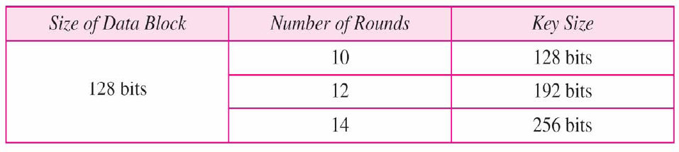
Advanced Encryption Standard
Also called Rijndael Algorithm
128 bit blocks, keys:-128, 192,256 bits long
NIST (National Institute of Standards and Technology) estimates that a machine that could crack 56-bit DES in one second (2^55 keys per second) would take approx. 149 trillion years to crack a 128-bit AES key.
Notes:
All security policies and mechanisms rest on assumptions; we’ll examine some in later chapters, most notably Chapter 22, Malicious Logic. Here is a taste of the assumptions.
Policies: as these define security, they have to define security correctly for the particular site. For example, a web site has to be available, but if the security policy does not mention availability, the definition of security is inappropriate for the site. Also, a policy may not specify whether a particular state is “secure” or “non-secure.” This ambiguity causes problems.
Mechanisms: as these enforce policy, they must be appropriate. For example, cryptography does not assure availability, so using cryptography in the above situation won’t work. Further, security mechanisms rely on supporting infrastructure, such as compilers, libraries, the hardware, and networks to work correctly. Ken Thompson’s modified C preprocessor (see the example on p. 615) illustrates this point very well.

Slide 20
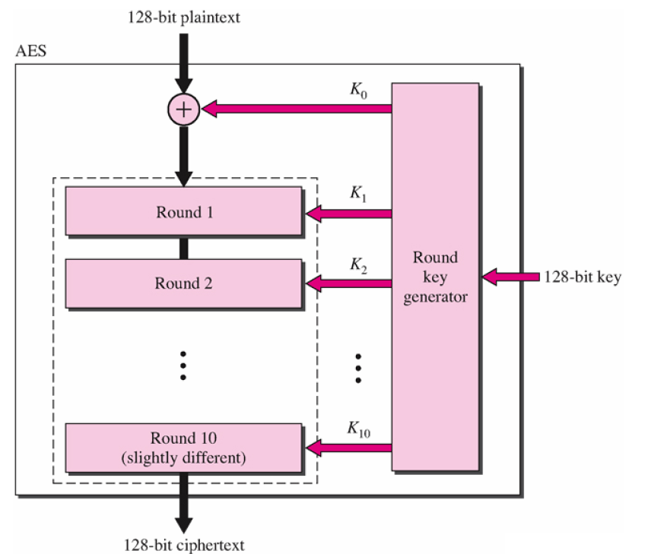
Advanced Encryption Standard
Notes:
All security policies and mechanisms rest on assumptions; we’ll examine some in later chapters, most notably Chapter 22, Malicious Logic. Here is a taste of the assumptions.
Policies: as these define security, they have to define security correctly for the particular site. For example, a web site has to be available, but if the security policy does not mention availability, the definition of security is inappropriate for the site. Also, a policy may not specify whether a particular state is “secure” or “non-secure.” This ambiguity causes problems.
Mechanisms: as these enforce policy, they must be appropriate. For example, cryptography does not assure availability, so using cryptography in the above situation won’t work. Further, security mechanisms rely on supporting infrastructure, such as compilers, libraries, the hardware, and networks to work correctly. Ken Thompson’s modified C preprocessor (see the example on p. 615) illustrates this point very well.

Slide 21
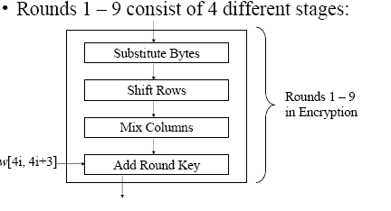
Advanced Encryption Standard

Slide 22
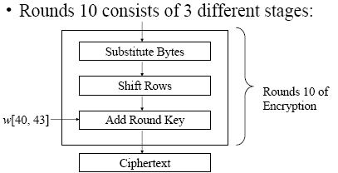
Advanced Encryption Standard
Notes:
All security policies and mechanisms rest on assumptions; we’ll examine some in later chapters, most notably Chapter 22, Malicious Logic. Here is a taste of the assumptions.
Policies: as these define security, they have to define security correctly for the particular site. For example, a web site has to be available, but if the security policy does not mention availability, the definition of security is inappropriate for the site. Also, a policy may not specify whether a particular state is “secure” or “non-secure.” This ambiguity causes problems.
Mechanisms: as these enforce policy, they must be appropriate. For example, cryptography does not assure availability, so using cryptography in the above situation won’t work. Further, security mechanisms rely on supporting infrastructure, such as compilers, libraries, the hardware, and networks to work correctly. Ken Thompson’s modified C preprocessor (see the example on p. 615) illustrates this point very well.

Slide 23
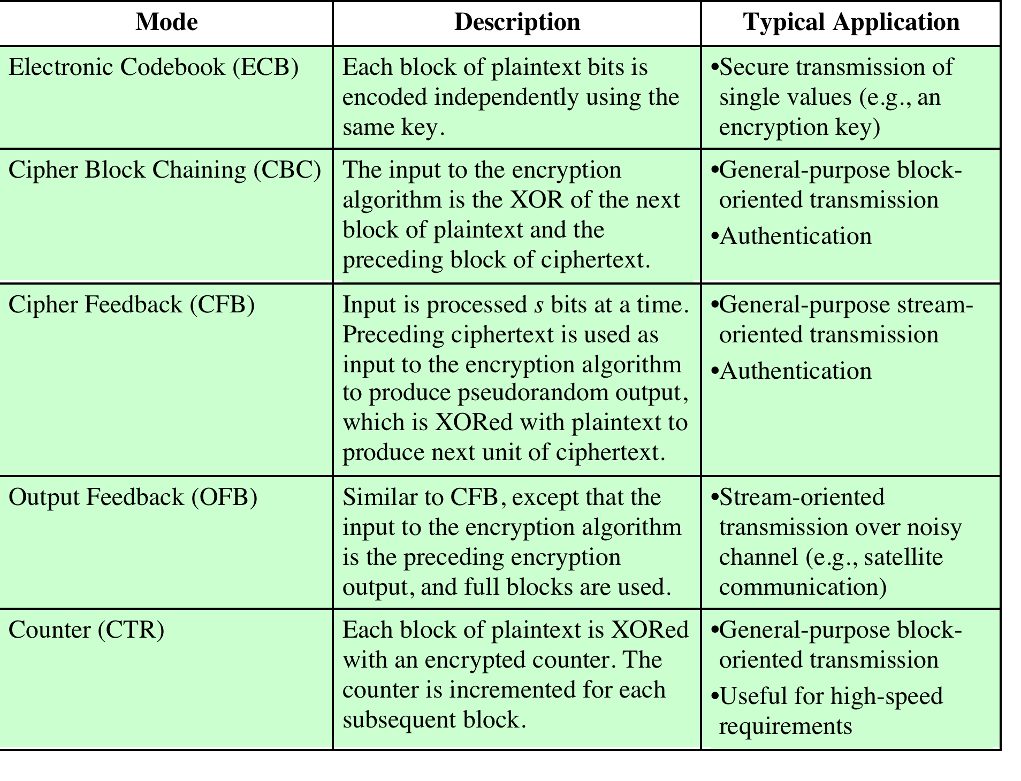
Notes:
The modes are summarized in Table 6.1 and described in this and the following sections.

Slide 24
Converting Block Cipher to Stream Cipher
There are three modes that make it possible to convert a block cipher into a stream cipher:
Cipher feedback (CFB) mode
Output feedback (OFB) mode
Counter (CTR) mode
For AES, DES, or any block cipher, encryption is performed on a block of b bits
In the case of DES b = 64
In the case of AES b = 128
Notes:
For AES, DES, or any block cipher, encryption is performed on a block of b bits. In
the case of DES, b = 64 and in the case of AES, b = 128. However, it is possible
to convert a block cipher into a stream cipher, using one of the three modes to be
discussed in this and the next two sections: cipher feedback (CFB) mode, output
feedback (OFB) mode, and counter (CTR) mode. A stream cipher eliminates the
need to pad a message to be an integral number of blocks. It also can operate in
real time. Thus, if a character stream is being transmitted, each character can be
encrypted and transmitted immediately using a character-oriented stream cipher.
One desirable property of a stream cipher is that the ciphertext be of the same
length as the plaintext. Thus, if 8-bit characters are being transmitted, each character
should be encrypted to produce a ciphertext output of 8 bits. If more than 8 bits
are produced, transmission capacity is wasted.

Slide 25
Modular Arithmetic
In integer arithmetic, if we divide a by n, we can get quotient q and remainder r. The relationship between these four integers can be shown as
a= q*n+r
Here, we call a the dividend; n, the divisor; q, the quotient; and r, the remainder.
Modulo operator for a positive integer n
r = a mod n
equivalent to
a = r + q*n
In Cryptograph, we need to impose two restrictions. First, we require that the divisor be a positive integer (n>0). Second, we require that the remainder be a nonnegative integer (r>=0).
Example:
29 mod 13 = 3 13 mod 13 = 0 -1 mod 13 = 12
29 = 3 + 2*13 13 = 0 + 1*13 12 = -1 + 1*13
Notes:
All security policies and mechanisms rest on assumptions; we’ll examine some in later chapters, most notably Chapter 22, Malicious Logic. Here is a taste of the assumptions.
Policies: as these define security, they have to define security correctly for the particular site. For example, a web site has to be available, but if the security policy does not mention availability, the definition of security is inappropriate for the site. Also, a policy may not specify whether a particular state is “secure” or “non-secure.” This ambiguity causes problems.
Mechanisms: as these enforce policy, they must be appropriate. For example, cryptography does not assure availability, so using cryptography in the above situation won’t work. Further, security mechanisms rely on supporting infrastructure, such as compilers, libraries, the hardware, and networks to work correctly. Ken Thompson’s modified C preprocessor (see the example on p. 615) illustrates this point very well.

Slide 26
Greatest Common Divisor
The greatest common divisor (GCD) of two positive integers a and b, denoted gcd(a, b), is the largest positive integer that divides both a and b
The above definition is extended to arbitrary integers
Examples:
gcd(18, 30) = 6
gcd(0, 20) = 20
gcd(-21, 49) = 7
Two integers a and b are said to be relatively prime if
gcd(a, b) = 1
Example:
Integers 15 and 28 are relatively prime
Notes:
All security policies and mechanisms rest on assumptions; we’ll examine some in later chapters, most notably Chapter 22, Malicious Logic. Here is a taste of the assumptions.
Policies: as these define security, they have to define security correctly for the particular site. For example, a web site has to be available, but if the security policy does not mention availability, the definition of security is inappropriate for the site. Also, a policy may not specify whether a particular state is “secure” or “non-secure.” This ambiguity causes problems.
Mechanisms: as these enforce policy, they must be appropriate. For example, cryptography does not assure availability, so using cryptography in the above situation won’t work. Further, security mechanisms rely on supporting infrastructure, such as compilers, libraries, the hardware, and networks to work correctly. Ken Thompson’s modified C preprocessor (see the example on p. 615) illustrates this point very well.

Slide 27
Multiplicative Inverses
The residues modulo a positive integer n are the set
Zn = {0, 1, 2, …, (n - 1)}, i.e., Zn = {x| 0≤x ≤ n-1, where x is a positive integer}.
Let Zn* = {x| 1≤x ≤ n-1, where GCD(x, n)=1, and x is a positive integer}
Zn* is the subset of elements of Zn relative prime with n or the set of invertible elements in Zn.
Examples:
for prime p, Zp* = {1,2,3,...,p-1}
Notes:
All security policies and mechanisms rest on assumptions; we’ll examine some in later chapters, most notably Chapter 22, Malicious Logic. Here is a taste of the assumptions.
Policies: as these define security, they have to define security correctly for the particular site. For example, a web site has to be available, but if the security policy does not mention availability, the definition of security is inappropriate for the site. Also, a policy may not specify whether a particular state is “secure” or “non-secure.” This ambiguity causes problems.
Mechanisms: as these enforce policy, they must be appropriate. For example, cryptography does not assure availability, so using cryptography in the above situation won’t work. Further, security mechanisms rely on supporting infrastructure, such as compilers, libraries, the hardware, and networks to work correctly. Ken Thompson’s modified C preprocessor (see the example on p. 615) illustrates this point very well.

Slide 28
Multiplicative Inverses
The multiplicative inverse of a modulo m exists iff a and m are coprime (i.e., if gcd(a, m) = 1).
The modular multiplicative inverse of a modulo m, is an integer x belongs to Zm*, such that a*x =1 (mod m).
If the modular multiplicative inverse of a modulo m exists, the operation of division by a modulo m can be defined as multiplying by the inverse, i.e., b/a mod m =b*(a^-1) mod m, Here a^-1 is a’s multiplicative inverse.
Notes:
All security policies and mechanisms rest on assumptions; we’ll examine some in later chapters, most notably Chapter 22, Malicious Logic. Here is a taste of the assumptions.
Policies: as these define security, they have to define security correctly for the particular site. For example, a web site has to be available, but if the security policy does not mention availability, the definition of security is inappropriate for the site. Also, a policy may not specify whether a particular state is “secure” or “non-secure.” This ambiguity causes problems.
Mechanisms: as these enforce policy, they must be appropriate. For example, cryptography does not assure availability, so using cryptography in the above situation won’t work. Further, security mechanisms rely on supporting infrastructure, such as compilers, libraries, the hardware, and networks to work correctly. Ken Thompson’s modified C preprocessor (see the example on p. 615) illustrates this point very well.

Slide 29
Multiplicative Inverses
Theorem: a has a multiplicative inverse modulo m, if and only if a is relative prime to m, i.e., GCD(a,m)=1.
Example: 3*x=1 mod 7, x = 1/3
x=5, 3*5 mod 7 = 15 mod 7=1
1/3 mod 7 =5, since 5*3=1 mod 7
Notes:
All security policies and mechanisms rest on assumptions; we’ll examine some in later chapters, most notably Chapter 22, Malicious Logic. Here is a taste of the assumptions.
Policies: as these define security, they have to define security correctly for the particular site. For example, a web site has to be available, but if the security policy does not mention availability, the definition of security is inappropriate for the site. Also, a policy may not specify whether a particular state is “secure” or “non-secure.” This ambiguity causes problems.
Mechanisms: as these enforce policy, they must be appropriate. For example, cryptography does not assure availability, so using cryptography in the above situation won’t work. Further, security mechanisms rely on supporting infrastructure, such as compilers, libraries, the hardware, and networks to work correctly. Ken Thompson’s modified C preprocessor (see the example on p. 615) illustrates this point very well.

Slide 30
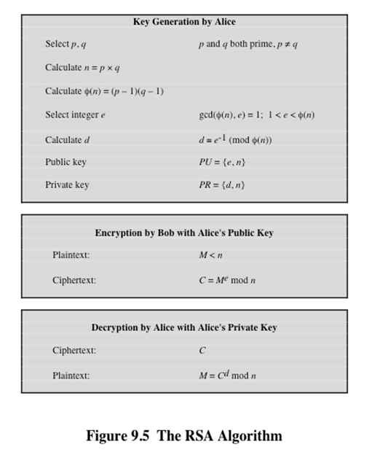
RSA Algorithm
Notes:
So far all the cryptosystems discussed have been private/secret/single key (symmetric) systems. All classical, and modern block and stream ciphers are of this form.

Slide 31
Hash and Message Digest
Notes:
All security policies and mechanisms rest on assumptions; we’ll examine some in later chapters, most notably Chapter 22, Malicious Logic. Here is a taste of the assumptions.
Policies: as these define security, they have to define security correctly for the particular site. For example, a web site has to be available, but if the security policy does not mention availability, the definition of security is inappropriate for the site. Also, a policy may not specify whether a particular state is “secure” or “non-secure.” This ambiguity causes problems.
Mechanisms: as these enforce policy, they must be appropriate. For example, cryptography does not assure availability, so using cryptography in the above situation won’t work. Further, security mechanisms rely on supporting infrastructure, such as compilers, libraries, the hardware, and networks to work correctly. Ken Thompson’s modified C preprocessor (see the example on p. 615) illustrates this point very well.

Slide 32
Requirements for Hash Functions
can be applied to any sized message M
produces fixed-length output h
is easy to compute h=H(M) for any message M
given h is infeasible to find x s.t. H(x)=h
one-way property
given x is infeasible to find y s.t. H(y)=H(x)
weak collision resistance
is infeasible to find any x,y s.t. H(y)=H(x)
strong collision resistance
Notes:
These are the specifications for good hash functions. Essentially it must be extremely difficult to find 2 messages with the same hash, and the hash should not be related to the message in any obvious way (ie it should be a complex non-linear function of the message). There are quite a few similarities in the evolution of hash functions & block ciphers, and in the evolution of the design requirements on both.

Slide 33
Secure Hash Algorithms
Notes:
All security policies and mechanisms rest on assumptions; we’ll examine some in later chapters, most notably Chapter 22, Malicious Logic. Here is a taste of the assumptions.
Policies: as these define security, they have to define security correctly for the particular site. For example, a web site has to be available, but if the security policy does not mention availability, the definition of security is inappropriate for the site. Also, a policy may not specify whether a particular state is “secure” or “non-secure.” This ambiguity causes problems.
Mechanisms: as these enforce policy, they must be appropriate. For example, cryptography does not assure availability, so using cryptography in the above situation won’t work. Further, security mechanisms rely on supporting infrastructure, such as compilers, libraries, the hardware, and networks to work correctly. Ken Thompson’s modified C preprocessor (see the example on p. 615) illustrates this point very well.

